Slide 1
Memory Management

Slide 2



Objectives
At the end of the lesson student should be able to
State what is meant by virtual memory
Given reason for virtual memory
Outline the concept of paging in a computer.
Explain how segmentation process of a computer memory

Slide 3

Memory Management

Slide 4
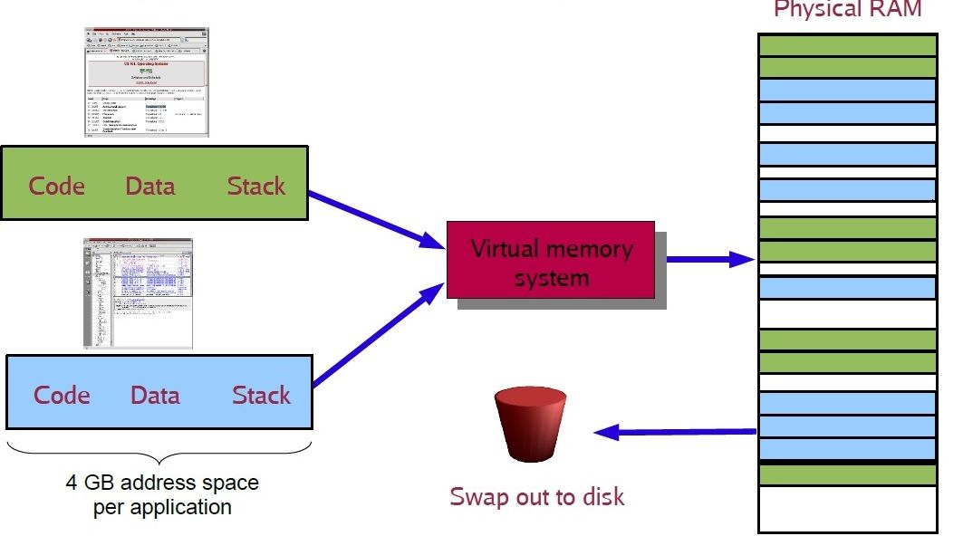
Virtual memory
Virtual memory is a feature of an operating system that enables a computer to compensate for shortages of physical memory by transferring pages of data from random access memory to disk storage.
This process is done temporarily and is designed to work as a combination of RAM and space on the hard disk.
It uses paging and segmentation for this
Why is memory allocation/management important?
It affects program speed
Its important for running multiple programs

Slide 5
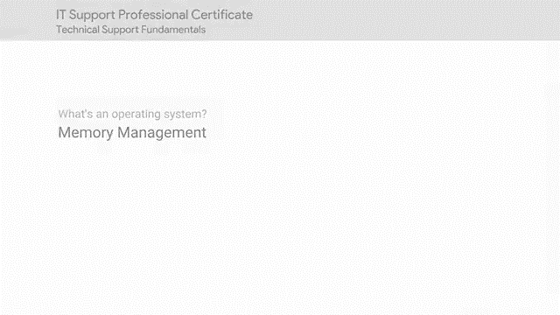
Video Review

Slide 6
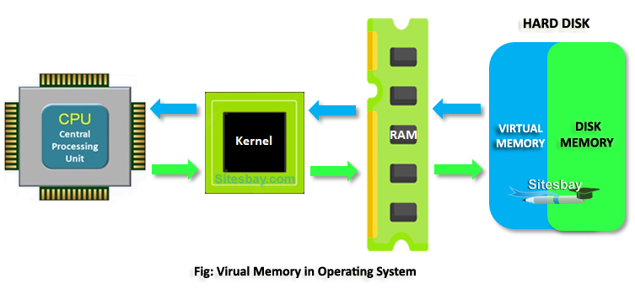
What is Paging?
Memory paging is a memory management function in which a computer stores and retrieves data from secondary storage for use in RAM.
The memory manager will look at the pages paging (working/active) in main memory and identify those which haven't been used for a while and then move those into virtual memory
When an application needs data held on a page in virtual memory it will be swapped back into main memory and another inactive page may take its place
Whenever a user is shown a message that says the virtual memory is running low, this means that either more RAM needs to be added, or the size of the paging file needs to be increased.

Slide 7
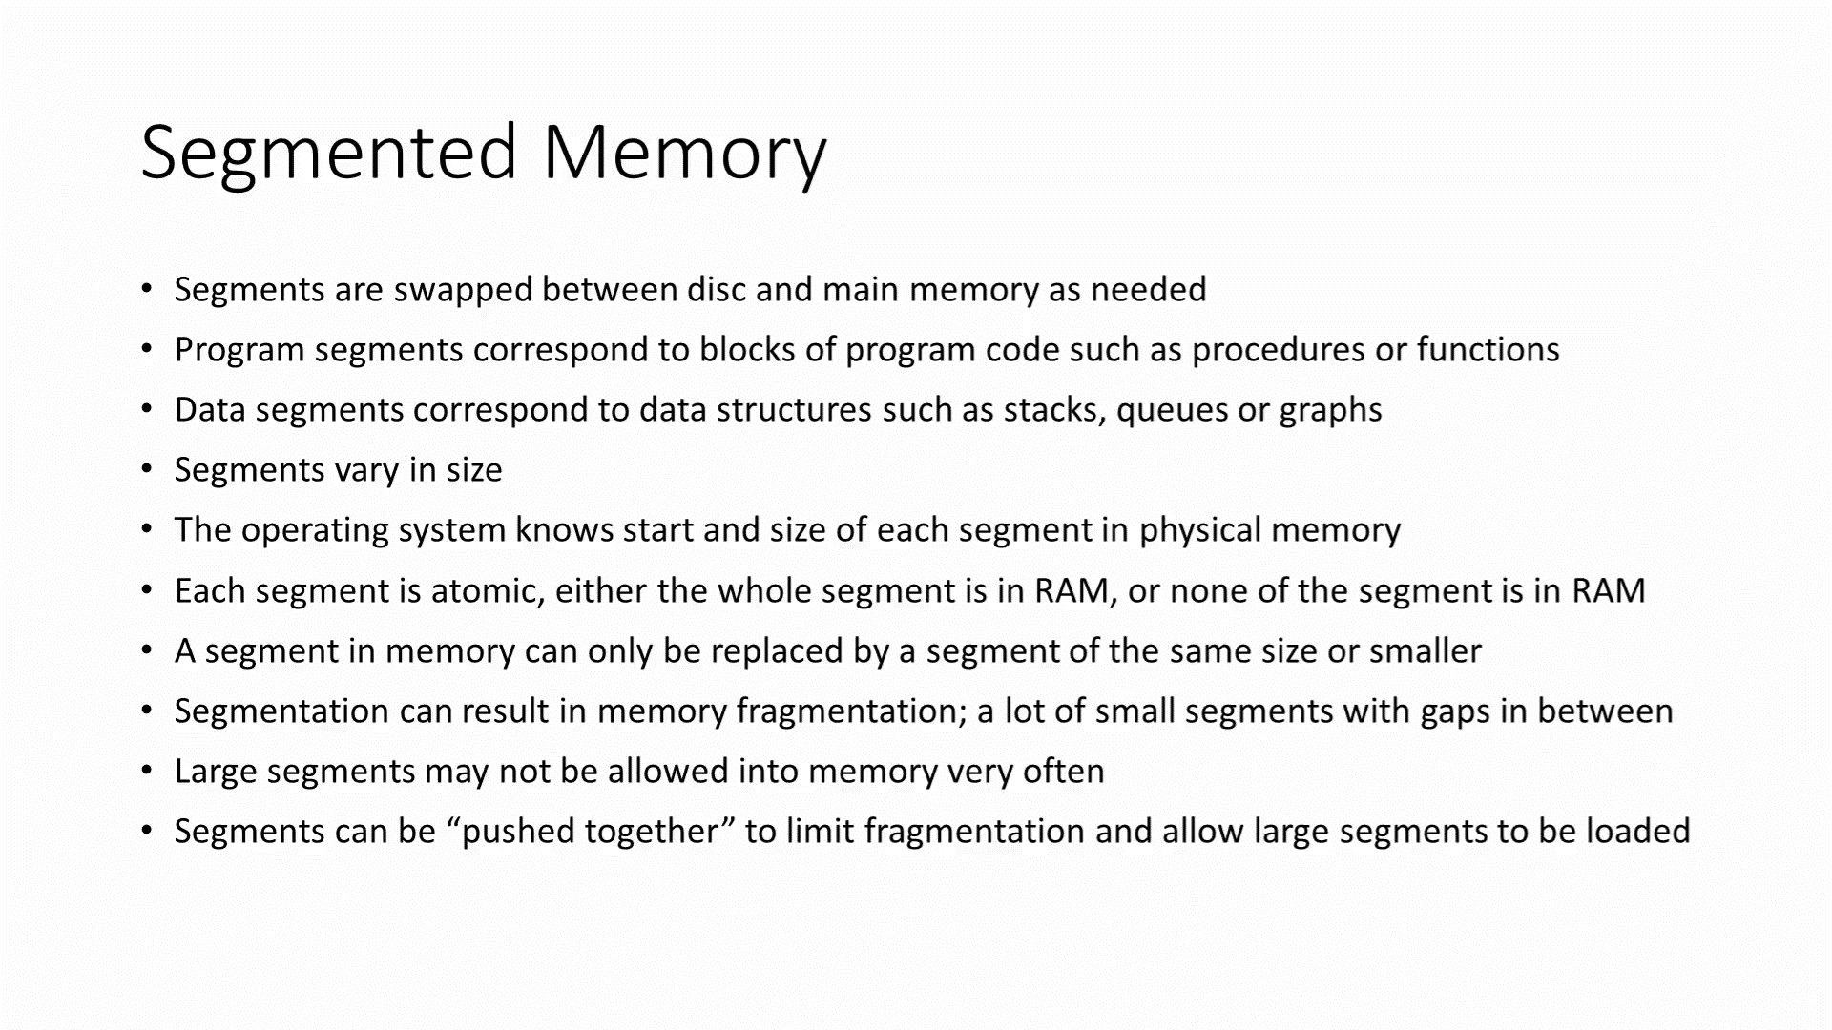
Paging Video
https://www.youtube.com/watch?v=p9yZNLeOj4s

Slide 8
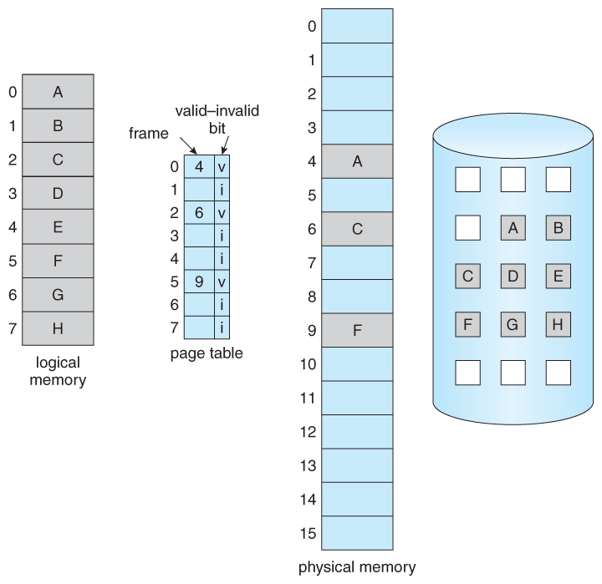
Paging
Paging is possible because the memory manager divides primary memory into sections of equal size - called pages. The pages are efficiently set to be the same size as the sectors on the hard disk.
In order to manage these pages a 'page table' is created by the memory manager which stores the starting address of each page.
The starting address is where the first byte of each page is physically located in memory.

Slide 9
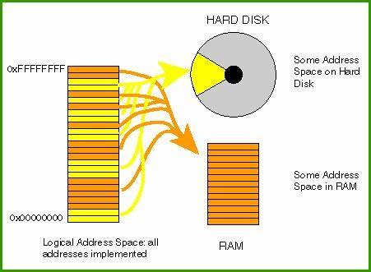
The Paging Process
The OS maintain a page table for each process that is carried out by the CPU, which is stored into RAM
The page table contains the address for each process block and its corresponding page in the main memory.
The OS creates this page table for each process loaded into RAM.
The CPU executes one process at a time and during this period the associate page table will be active.
The CPU only access the memory addresses only from the page table which is currently active
The operating system does not load all the bocks connected with the process but only those that are being used by the program

Slide 10
Advantages/Disadvantages of Paging
Advantages of Paging
Easy to use memory management algorithm
No need for external Fragmentation
Swapping is easy between equal-sized pages and page frames.
Disadvantages of Paging
May cause Internal fragmentation
Complex memory management algorithm
Page tables consume additonal memory.
Multi-level paging may lead to memory reference overhead.

Slide 11
What is memory Segmentation?
Memory segmentation is the process in which the RAM is divided into various size parts.
Each part is known as a segment and is given to a process.
All the details of the divided segments are stored in the segment table. The segment table contains two information about the segment:
the base address of the segment
the length of the segment.

Slide 12
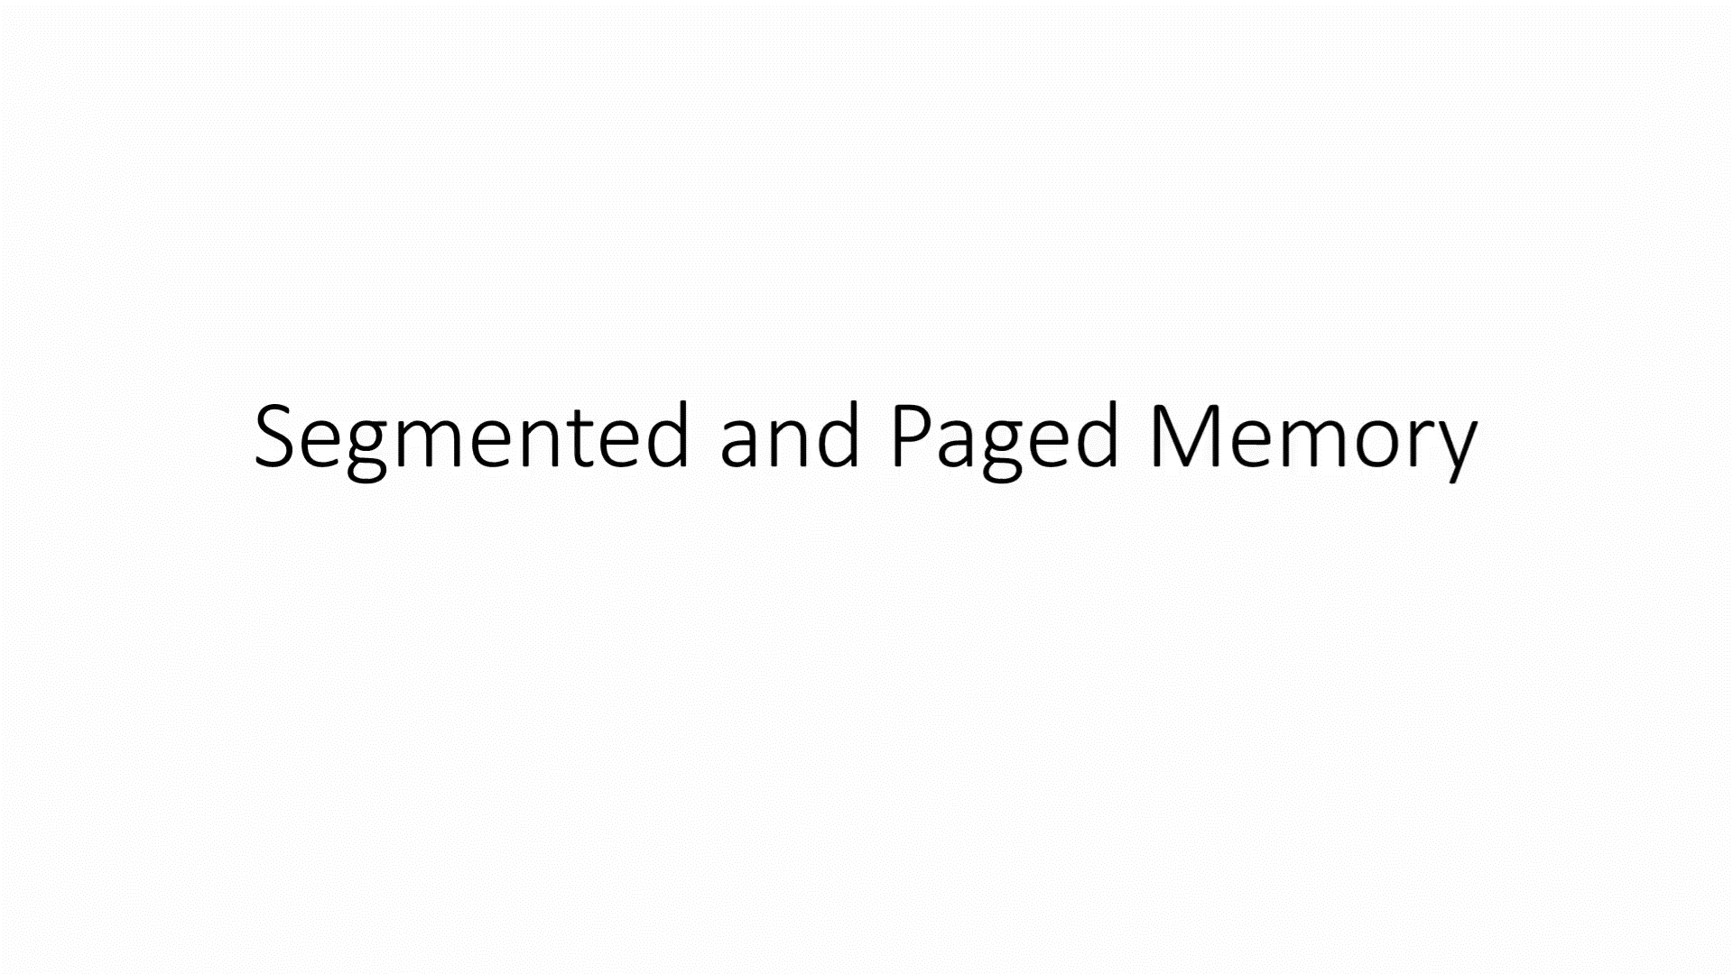
Video- Segmentation
https://www.youtube.com/watch?v=p9yZNLeOj4s

Slide 13
Advantages/ Disadvantages of Memory Segmentation
Advantages of Memory Segmentation
• There is less overhead in segmentation. • There is no internal fragmentation as external fragmentation is done in this. • The size of the segment table is less whereas the size of the page table is big in paging. • The average size of the segment is more as compared to the actual size of the page. • We can easily relocate the segments as compared to the address space.
Disadvantages of Memory Segmentation
• It is a costly technique as compared to the other one. • External fragmentation is there in it. • Since there is a variably sized partition. So, it is difficult to allocate memory to them.

Slide 14
Difference Between Paging and Segmentation
Paging | Segmentation
Paging is closer to our operating system. | Segmentation is closer to the user rather than the operating system.
There is no need of doing any external fragmentation. | There is external fragmentation in segmentation.
In this, the page information is stored in the page table. | In this, the information about segments is stored in the segment table.
In this, our operating system is responsible. | In this, the compiler is responsible for the working.
Paging suffers from internal fragmentation instead of external fragmentation. | Segmentation suffers from external fragmentation rather than internal fragmentation.
Paging divides our program into various fixed size pages. | Segmentation divides our program into various variable size segments.
In this, the logical address is divided into two things; page number and page offset. | In this, the logical address is divided into two things: segment number and segment offset.
Paging is faster than segmentation. | Segmentation is slower than paging.
It is a non-contiguous memory allocation. | It is a non-contiguous memory allocation.
The entry of the page table contains flag bits and frame number so that it can represent the details about the pages. | On the other hand, the entry of segment table contains base address and some protection bits of the segments.

Slide 15

Students’ Activity
Record the answers to the following questions in your copy books
One role of the operating system is the provision of a virtual machine What does this mean?
Explain in detail using the correct computer terms how a virtual machine is created
State the difference between paging and segmentation

